Slide 1


Social Media
ACWA Seminar on

Slide 2

Contents:
Social media Introduction: p3 – 4
Social media facts & figures / Facebook users & Car Wash users demographics: p5 - 6
Top Ten social media sites: p7
LinkedIn: p8
Twitter :p9
Facebook: p10
How Facebook helps businesses: p11 - 27
Success stories: p28
Example of good pages: p29 - 30
Social media beware: p31 - 33
Resources / Further Reference: p34

Slide 3
Social Media Intro:
Social media is an interactive channel that allows people to do what they have always done; connect with their friends, family members, co-workers, employees etc. For businesses, the connection with its customers is paramount.
Social networking involves the use of the internet which allows users to connect with but not limited to; friends, family and acquaintances. Social networking websites are not necessarily about meeting new people online, although this does occur. They are primarily about connecting with friends, family and acquaintances known to you in real life. The most well known social networking sites are; Facebook, Twitter, MySpace and Bebo. These sites allow you to share; photos, videos and information, organise events, chat, download music and play games like Scrabble and Chess online amongst other uses.

Slide 4
Social Media Intro Continued:
Often, each of your “friends” (Facebook) or “followers” (Twitter) will be “friends” with several of your other “friends”. Just like in real life, the connections between people aren’t just one-on-one, but a network of connections. This online social network is very useful in spreading information via text, pictures and/or videos. For example, you can easily set up a web page with details and pictures of an event you might be planning, such as a school fete. The site allows you to easily send out invitations to other users of the social networking site. Then, if given the option by the host, those who are invited can send out more invites to their friends who might like to attend – hence, the network.

Slide 5
Demographics of Social Media:
Research findings:
Facebook still skews young, but the 45- to 54-year-old age bracket has seen 45% growth since year-end 2012. Among U.S. Internet users, 73% with incomes above $US75,000 are on Facebook (compared to 17% who are on Twitter). 86% of Facebook’s users are outside the U.S.
Instagram: 60% of Instagram’s users are women.
Twitter has a surprisingly young user population for a large social network — 27% of 18 to 29-year-olds in the U.S. use Twitter, compared to only 16% of people in their thirties and forties.
LinkedIn is international and skews toward male users.
Google+ is the most male-oriented of the major social networks. It’s 70% male.
Pinterest is dominated by tablet users. And, according to Nielsen data, 84% of U.S. Pinterest users are women.
Tumblr is strong with teens and young adults interested in self-expression, but only 8% of U.S. Internet users with incomes above $US75,000 use Tumblr.

Slide 6
Car Wash Customers Demographics:
Male 63% to female 37%. The reason for this discrepancy in the male to female ratio is generally attributed to the fact that men typically care more about their automobiles. Men are more likely to spend money on their cars with accessories and are more likely to buy a car as a reward for some accomplishment or as a treat for themselves. Women tend to view cars more so as an object of utility. Using this line of reasoning, women are more likely to use the automatic car wash as they are less concerned about preserving their "precious" car.
40% of the households have an income exceeding $70,000.
73% of the target population have an undergraduate degree, 39% have a graduate degree.

Slide 7
Top Ten Social Network Sites:
 | Total Users | Percentage of Australia’s Population (22,905,450)
Facebook | 11,784,460 | 51.45%
YouTube | 10,790,715 | 47.11%
LinkedIn | 3,924,421 | 17.13%
Tumblr | 2,992,048 | 12.77%
Twitter | 2,925,383 | 12.76%
WordPress | 2,735,586 | 11.94%
Pinterest | 1,409,197 | 6.15%
Flicker | 1,202,510 | 5.25%
Instragram | 915,746 | 4.00%
MySpace | 615,534 | 2.69%
Source: http://www.adcorp.com.au/Social-Media-Statistics-January-2013-Aust-NZ

Slide 8

What is
LinkedIn is an online social network for business professionals. It’s different from other social networking sites like facebook, because it’s designed specifically for professional networking such as; finding a job, discovering sales leads, connecting with potential business partners, rather than simply making friends and sharing photos.

Slide 9

What is
Twitter, at its most basic, is a series of short online announcements or ‘tweets’.
Twitter is a tool for micro-blogging, or posting a very short updates, comments or thoughts.
Another way to think of twitter is like a cross between instant messaging (IM) and a chat room, because it is an open forum with people you are connected to.

Slide 10

What is
Facebook is a popular free social networking website that allows registered users to create profiles, upload photos and video, send messages and keep in touch with friends, family and colleagues. The site, which is available in 37 different languages, includes public features such as:
Marketplace - allows members to post, read and respond to classified ads.
Groups - allows members who have common interests to find each other and interact.
Events - allows members to publicise an event, invite guests and track who plans to attend.
Pages - allows members to create and promote a public page built around a specific topic.
Presence technology - allows members to see which contacts are online and chat.

Slide 11
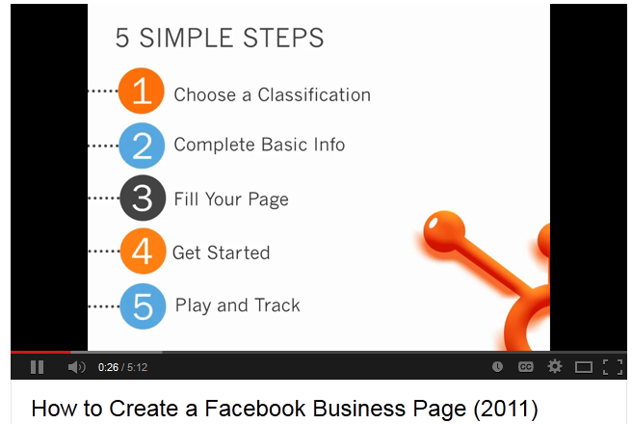
How to create a Facebook page:
http://www.youtube.com/watch?v=VoqxA95KC0c

Slide 12
How Facebook can help your business:
Establishes another outpost for your business on the web.
Drives traffic to your website.
Improves your SEO (Search Engine Optimisation).
Allows you to engage with your community easily and for free.
Allows you to engage with your community easily and for free.

Slide 13
How Facebook can help your business:
Strengthens customer relations.
Provides a breeding ground and platform for brand evangelists.
Listening and observing has the potential to improve your business.
Return On Investment (R.O.I)-related metrics are readily available.
Allows you to keep pace with the competition free of charge.

Slide 14
10 Tips to create engaging Page posts:
1. Use link posts to drive people to your website.
2. Use engaging copy, images and videos.
3. create a two-way conversation.
4. share exclusive discounts and promotions.
5. Provide access to exclusive information.
6. Be timely.
7. Plan your conversational Calendar.
8. Schedule your posts.
9. Target your posts.
10. Review the performance of your posts.

Slide 15
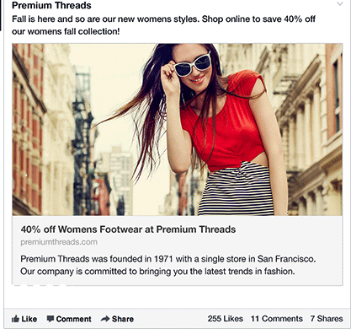
10 Tips to create engaging Page posts:
1. Use link
posts to drive people to your website

Slide 16
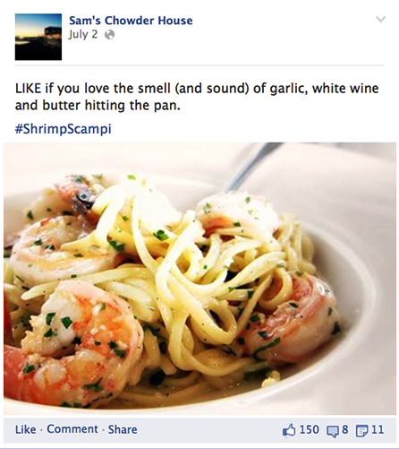
10 Tips to create engaging Page posts:
2. Use engaging copy, images and videos

Slide 17
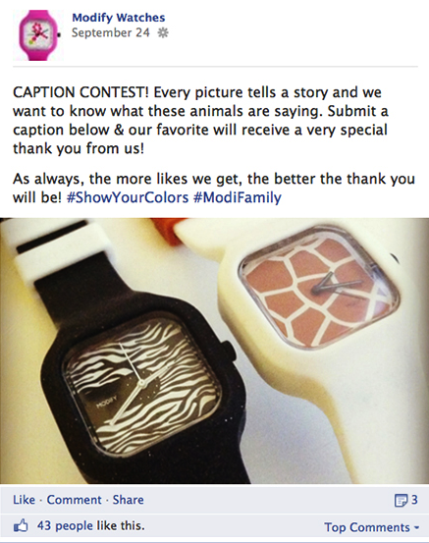
10 Tips to create engaging Page posts:
3. create a two-way conversation

Slide 18
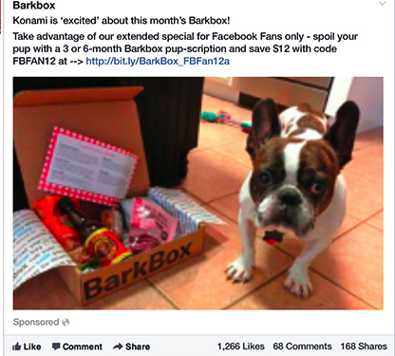
10 Tips to create engaging Page posts:
4. share exclusive discounts and promotions

Slide 19
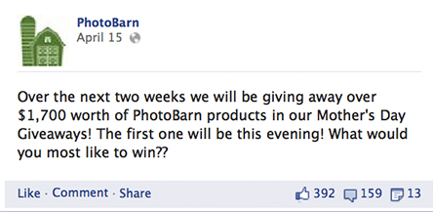
10 Tips to create engaging Page posts:
5. Provide access to exclusive information

Slide 20
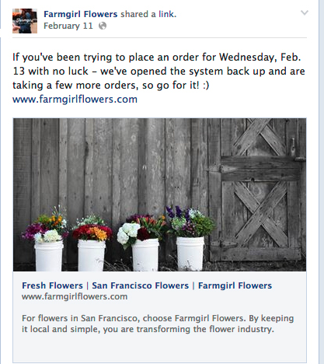
10 Tips to create engaging Page posts:
6. Be timely

Slide 21
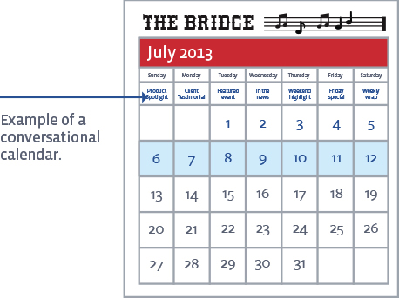
10 Tips to create engaging Page posts:
7. Plan your conversational Calendar

Slide 22
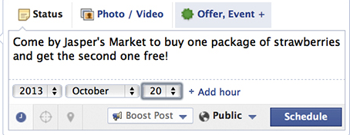
10 Tips to create engaging Page posts:
8. Schedule your posts

Slide 23
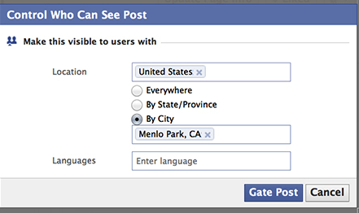
10 Tips to create engaging Page posts:
9. Target your posts

Slide 24
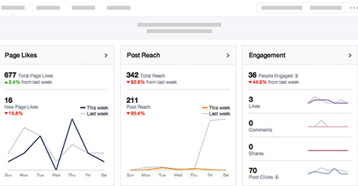
10 Tips to create engaging Page posts:
10. Review the performance of your posts.

Slide 25
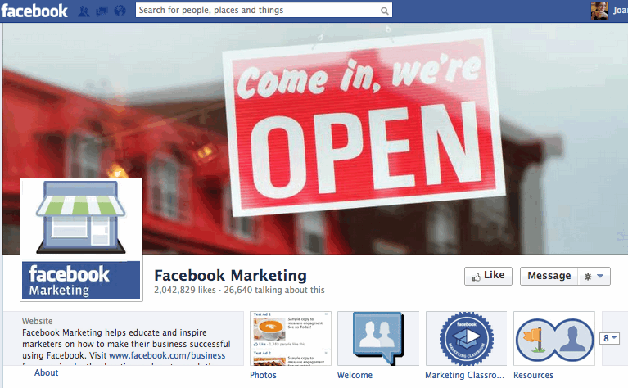
What makes a good page?
Greatest Quantity
Largest Variety
Consistent Professionalism
Visually Appealing

Slide 26
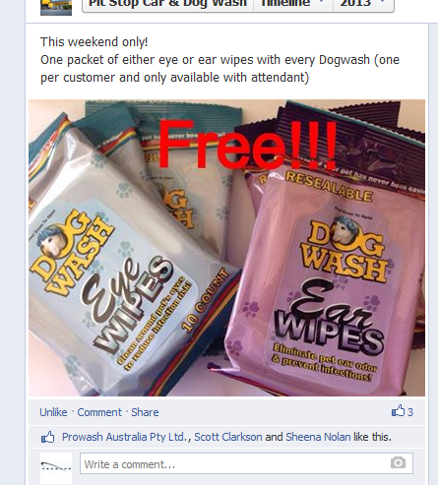
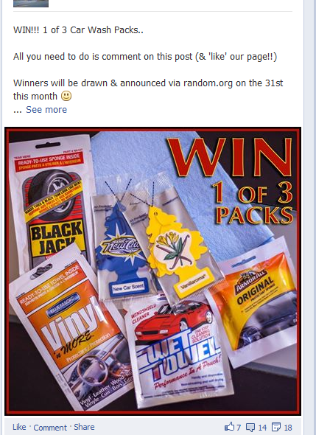
Example of a good page:
https://www.facebook.com/PitstopCarwashWindaroo?fref=ts

Slide 27
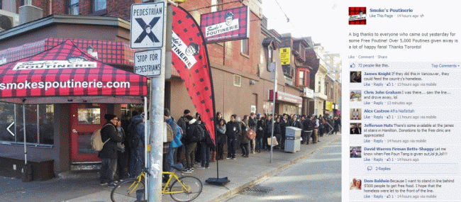
Example of a good page:
http://smallbiztrends.com/2013/11/facebook-marketing-succcess-french-fry-empire.html

Slide 28
Success Stories:
https://www.facebook.com/business/success
https://www.facebook.com/business/success/kwik-kar-auto
http://www.socialmediaexaminer.com/9-facebook-marketing-success-stories-you-should-model/

Slide 29
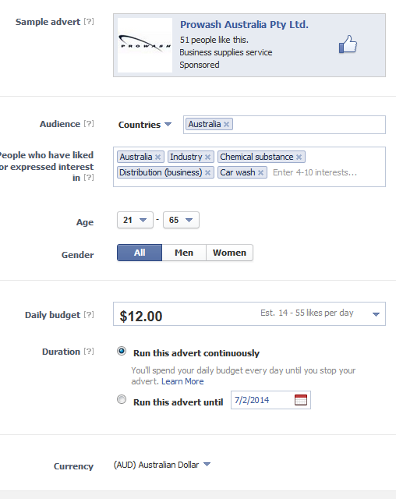

How to promote your Facebook page:

Slide 30
Social media – Beware:
Never give out personal and/or confidential information.
Social networking sites have a variety of privacy settings you can adjust. This means you can control who sees your profile page and other information you share on the site. Some people do not mind having their personal information available for anyone to view online. However, we strongly recommend that you don’t publish your home address and be mindful of posting other personal information about yourself (including your birthday), or others - especially if you don’t have their permission.
It’s worth keeping in mind that if malicious parties have access to your full name and date of birth and using other available information – for example which suburb you live in - it is possible that you could fall victim to identity theft. Just as you wouldn’t give your mobile number or bank details to anyone who asked, you should guard access to all the details of your social networking account. For more on this issue, visit the SCAMwatch website: http://www.scamwatch.gov.au/content/index.phtml/tag/identitytheft

Slide 31

Social media – Beware Continued:
Some people who use social networking sites prefer only to allow people they have officially become friends with to see their profile and other information. It is important to note that for most social networking sites (including Facebook and MySpace) the default privacy setting is not to hide your information when you sign up. If you don’t want your profile and other information to be seen by people who you have not authorised to be your “friend” or “follower”, you will have to check these settings and adjust them accordingly after you sign up – look around the page for a link to “Privacy” or “Settings”.

Slide 32
Social networking safety:
On the whole, nearly all the interactions that go on via social networking sites are safe. However, you need to be conscious of your safety and what you want people to see of yourself and your friends. Furthermore, everyone should remember these safety tips:
You are not obliged to accept a friend request from someone you don’t know or do not want to be in contact with;
Be respectful of others privacy if and when posting photos or videos of them, or mentioning them where others might read about it;
Be aware that you can remove someone as a “friend” and / or block them from interacting with you even after you have “accepted” them; and
Change your privacy settings so that only your friends can see your profile page.

Slide 33
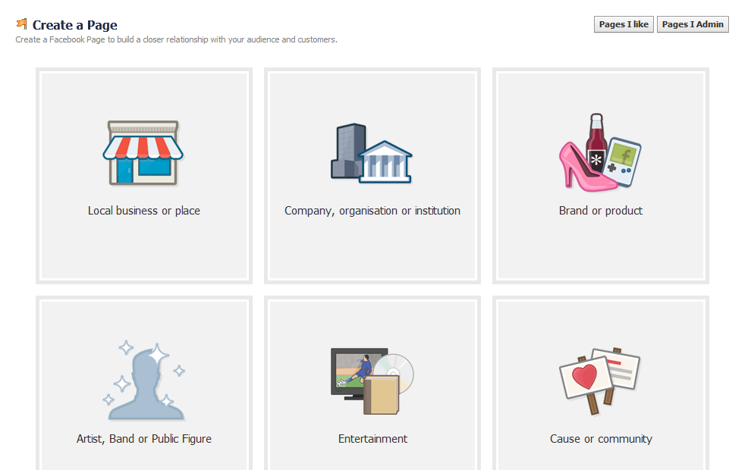
Let’s get into groups and start to create a Facebook page

Slide 34
Please give me your email if you wish to receive the following ebooks:
New facebook Business Page Timelines (pdf)
An Introduction to LinkedIn for Business (pdf)
Youtube link for starting your own facebook page. (video)
How to use Twitter for Business (pdf)
How to read Facebook insights and analytics (pdf)

Slide 35
THANK YOU

